Slide 2
Union in C
Similar to structures, a union is a collection of variables of different data types.
The only difference between a structure and a union is that in case of unions, you can only store information in one field at any one time. To better understand a union, think of it as a chunk of memory that is used to store variables of different types.
When a new value is assigned to a field, the existing data is replaced with the new data.

Slide 3
. Thus, unions are used to save memory.
They are useful for applications that involve multiple members, where values need not be assigned to all the members at any one time

Slide 4
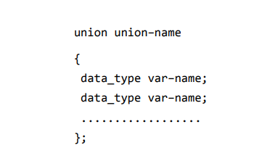
Declaration Union

Slide 5
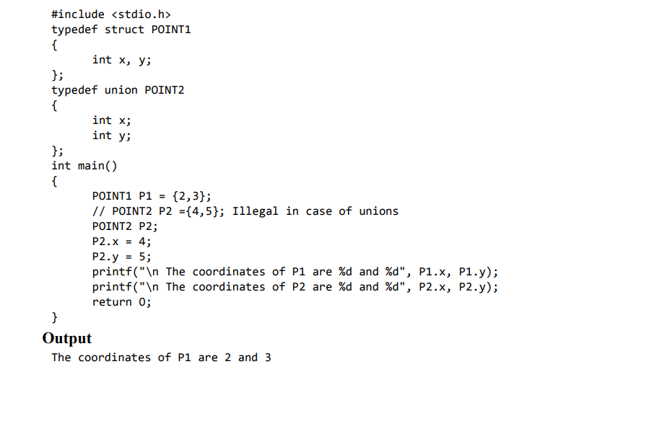
Initialization
The coordinates of P2 are 5 and 5

Slide 6

Initialization

Slide 7
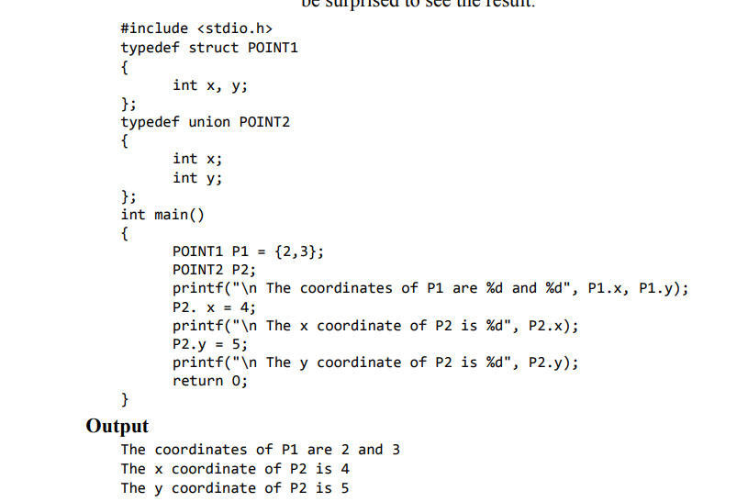
Initialization

Slide 8
Structure is a user-defined data type that can store
related information (even of different data types)
together.
A structure is declared using the keyword struct,
followed by the structure name.
Like any data type, memory is allocated for the structure when we declare a variable of the structure.

Slide 9
When a struct name is preceded with the keyword
typedef, then the struct becomes a new type.
When the user does not explicitly initialize the
structure, then C automatically does it. For int and
float members, the values are initialized to zero and
char and string members are initialized to '\0' by
default.
A structure member variable is generally accessed
using a '.' (dot) operator.
A structure can be placed within another structure.
That is, a structure may contain another structure
as its member. Such a structure is called a nested
structure.

Slide 10
Self-referential structures are those structures that
contain a reference to data of its same type. That is,
a self-referential structure, in addition to other data,
contains a pointer to a data that is of the same type
as that of the structure.
A union is a collection of variables of different
data types in which memory is shared among these
variables. The size of a union is equal to the size of
its largest member.
The only difference between a structure and a union
is that in case of unions information can only be
stored in one member at a time

